Slide 1
Capstone Project Bike Sharing Demand Prediction
Team members
Mujahid Sayyed Sarthak Gupta Lova Kumar Poluparti

Slide 2
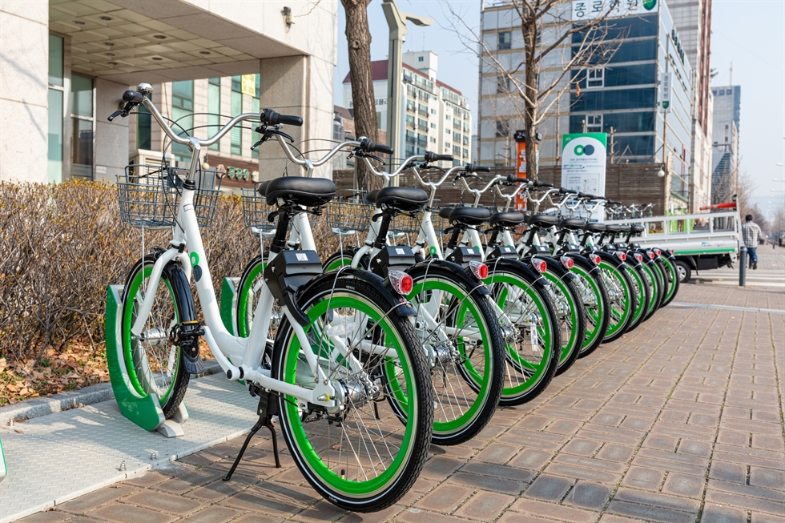
Contents
Introduction
Problem Statement
Points for discussion
Data Summary
Exploratory Data Analysis
Modeling Overview
Feature Importance
Conclusion

Slide 3
Introduction
A bike rental or bike hire business rents out motorcycles for short periods of time, Usually for a few hours. Most rentals are provided by bike shops as a sideline to their main businesses of sales and service, but some shops specialize in rentals.
As with car rental, bicycle rental shops primarily serve people who do not have access to vehicles, typically travelers and particularly tourists.
Bike rental shops rent by the day or week as well as by the hour, and these provide an excellent opportunity for those who would like to avoid shipping their own bikes but would like to do a multi-day bike tour of a particular area.

Slide 4

Problem Statement
Currently, Rental bikes are introduced in many urban cities for the enhancement of mobility comfort.
It is important to make the rental bike available and accessible to the public at the right time as it lessens the waiting time.
Eventually, providing the city with a stable supply of rental bikes becomes a major concern.
The crucial part is the prediction of the bike count required at each hour for the stable supply of rental bikes.

Slide 5
Discussion Topics
Bike booking in each season, on functioning days, holidays, and months.
Comparing Rented Bike Count against Numerical data columns.
Checking for Linear relation between the Rented bike count and the Numerical data columns.
Climate Effect in Different seasons on Bike Sharing.
Heat Map(OR) Correlation Map.
Linear Regression analysis, Lasso Regression Analysis, Grid Search CV for Hyperparameter tuning,
Decision Tree Analysis, Cat Boost, XG boost, and Random Forest Analysis
Feature Importance.

Slide 6
Data Analysis Steps
Imported Libraries
In this part, we imported the required libraries NumPy, Pandas, matplotlib, and seaborn, to perform Exploratory Data Analysis and for prediction, we imported the Scikit learn library.
Descriptive Statistics
In this part, we start by looking at descriptive statistic parameters for the dataset. We will use describe() this told mean, median, standard deviation
Missing Value Imputation
We will now check for missing values in our dataset. after checking not existed any missing values, In case there are any missing entries, we will impute them with appropriate values.
Graphical Representation
We will start with Univariate Analysis, bivariate Analysis and conclude with various prediction models driving the Demand for bikes.

Slide 7
Attributes of each variable
Date: Date in year-month-day format
Rented Bike Count: Count of bikes rented at each hour
Hour: Hour of the Day
Temperature: Temperature in Celsius
Humidity: Humidity in %
Windspeed: Speed of wind in m/s
Visibility (10m): Visibility
Dew point temperature: Dew Point Temp (Celsius)
Solar radiation: Radiation in MJ/m2
Rainfall: Rainfall (mm)
Snowfall: Snowfall (cm)
Seasons: Winter, Spring, Summer, Autumn
Holiday: Holiday/No holiday
Functioning Day: if the day is neither weekend, holiday than 1 else 0

Slide 8
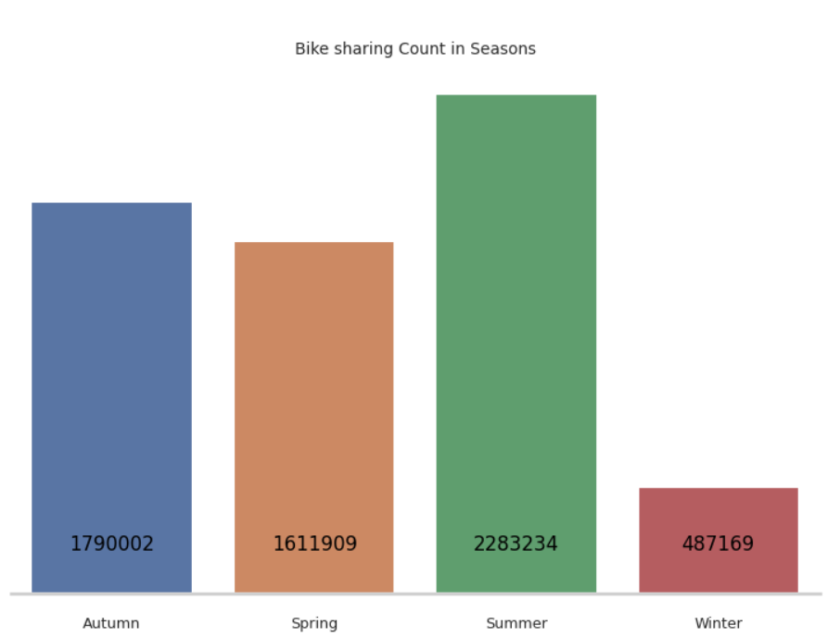
Bikes Rented per Season
Highest number of bikes were rented in Summer. The total count of bikes rented in summer was 2.28 million
Second highest Bikes were rented in Autumn around 1.79 million followed by Spring in which 1.6 million bikes are rented.
Winter appears to be the least popular season for bike rentals. In the winter, just 487K bikes were rented.
The extreme temperatures in Seoul in the winter might be a factor in the low demand for bikes in the winter.

Slide 9
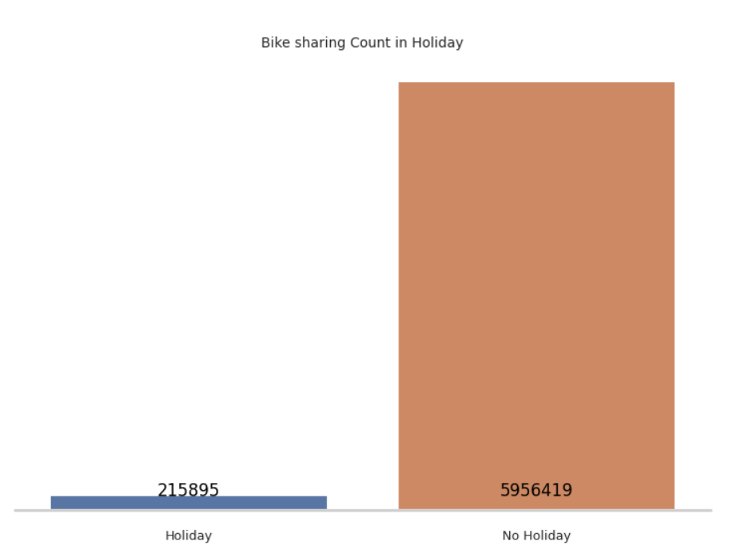
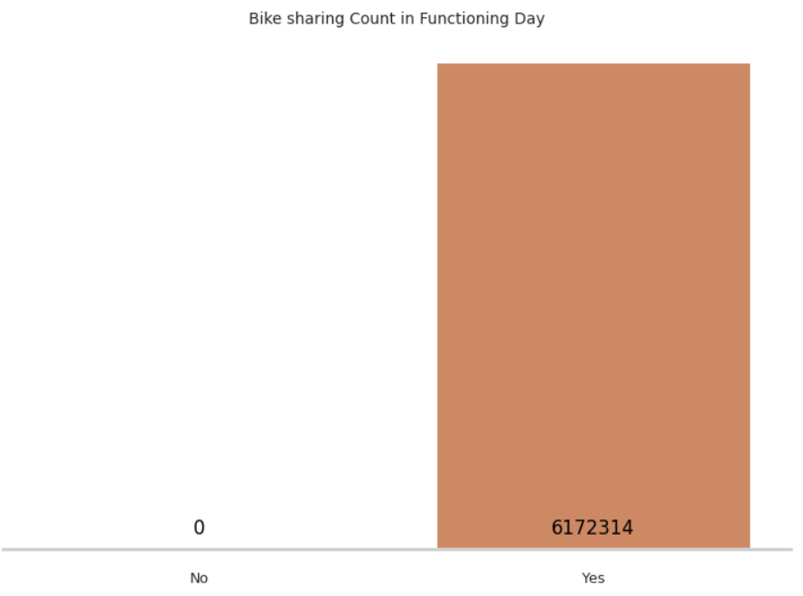
Bike Renting trend on holidays, Functioning days
People prefer to use the bike on Non-holiday more compared to Holidays.
5.9 million bikes are rented on Non-holidays, only a meager 215K bikes were rented on holidays.
It's reasonable to conclude that the majority of clients in the bike rental sector are from Seoul's working class.
All the bikes rented were on the functioning days.

Slide 10
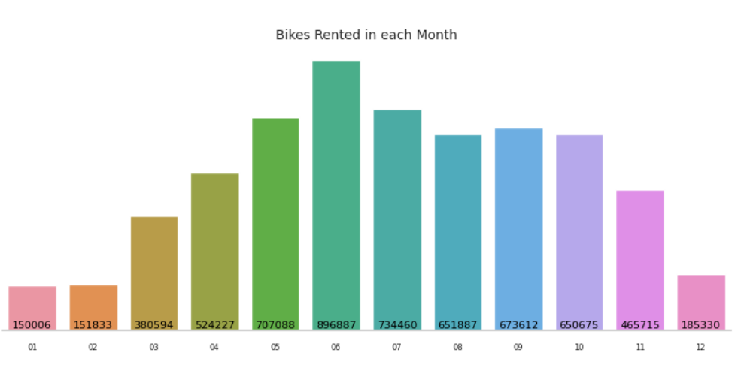
Bike Booking Monthly Trend
June is the most preferred month for bike booking around 896K bikes were rented in June.
July and May are the second and third best.734K bikes were booked in July, and 707K were booked in May.
Demand for bikes was least in Jan, followed by Feb and Dec. 150K bikes were rented in Jan, 151k in Feb, and 185K in Dec.

Slide 11
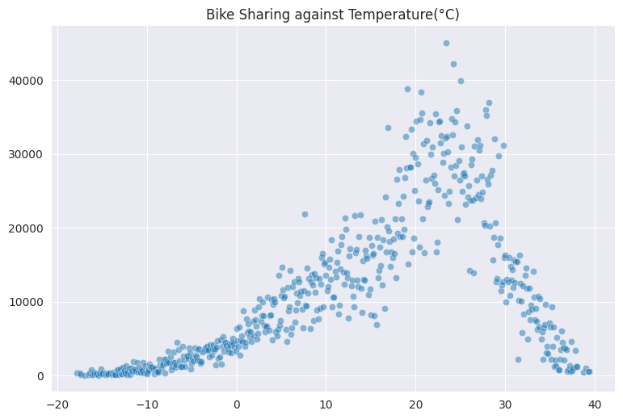
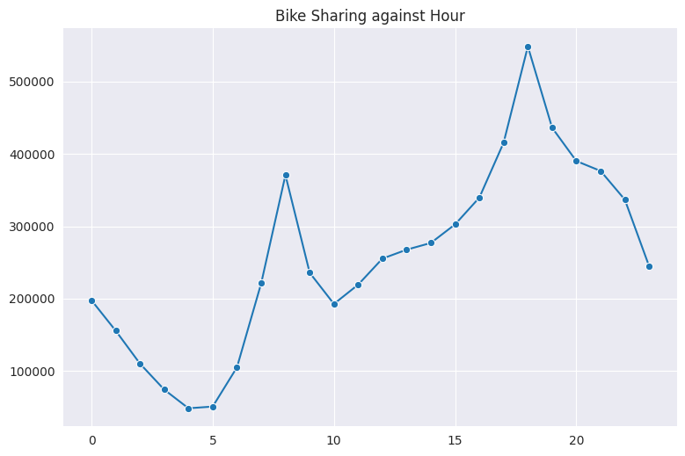
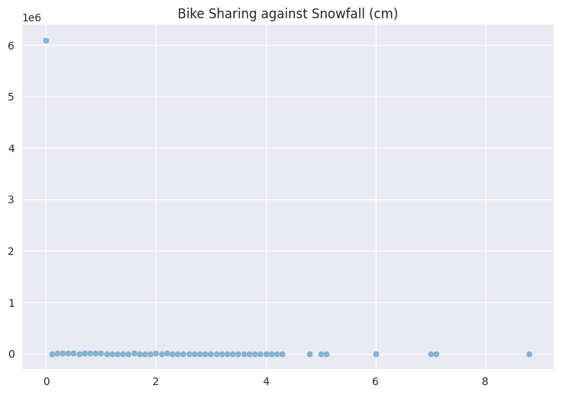
Rented Bike Count Against Numerical Data
Most preferred bike-sharing temperature is 20- 30 degrees Celsius. Bike renting is minimal when the temperature is >35 or <5 degrees Celsius.
Bike sharing is at its peak between 4 pm to 8 pm. Bike-sharing is at least between 2 am to 6 am, it increases from 6 am onwards until 8 am.
Snowfall is least favorable for the bike renting Business.

Slide 12
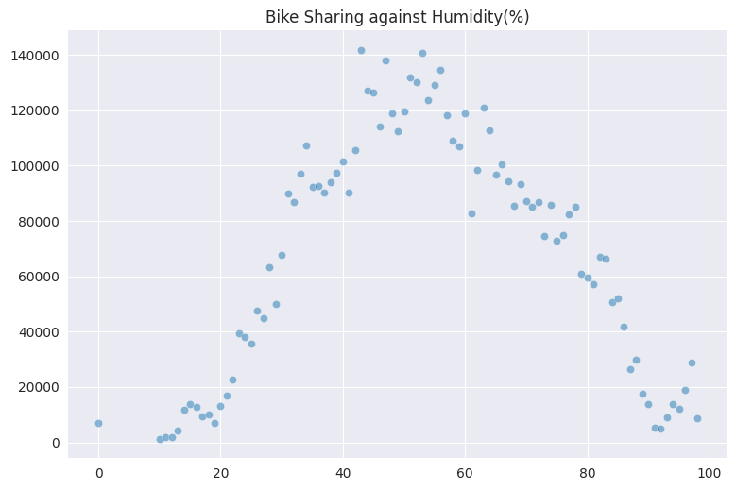
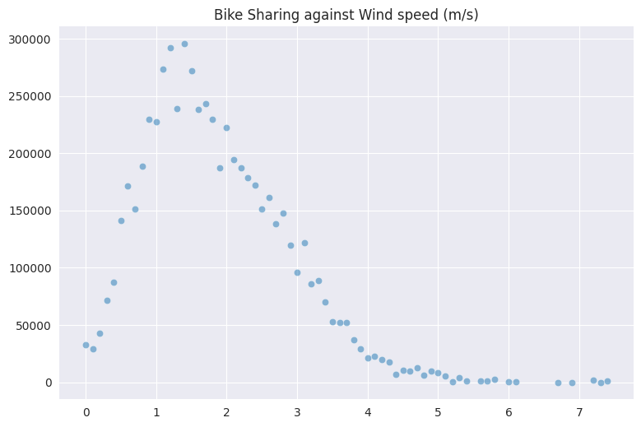
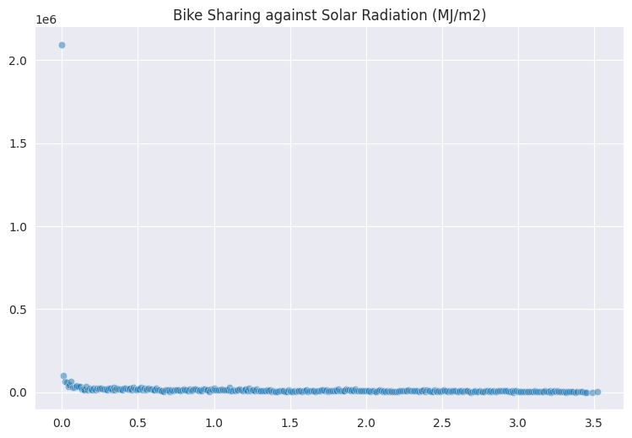
Rented Bike Count Against Numerical Data
Bike renting is at its peak when the humidity is 40%- 60%. People avoid bikes when the climate is too humid or too dry.
Favorable wind speed for Bike sharing is 1m/s -2 m/s as wind speed goes beyond 2m/s the count of bike-sharing starts dropping reaching minimal when the speed > 5m/s.
Bike sharing is at its peak when the radiation is minimal.

Slide 13
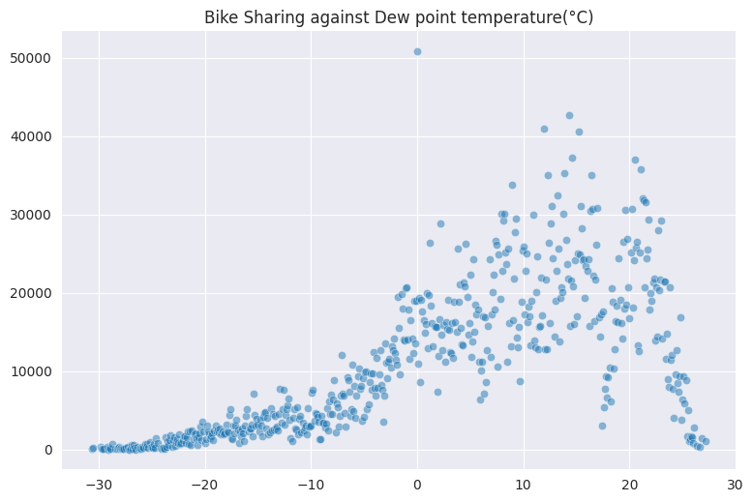
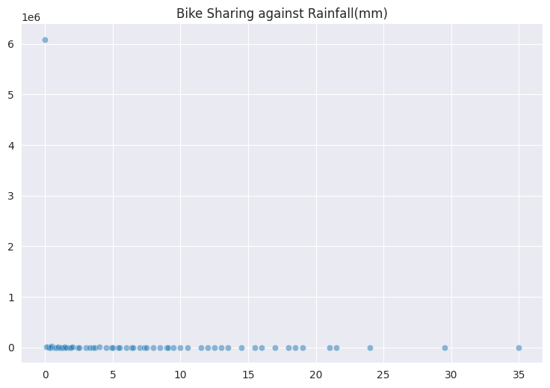
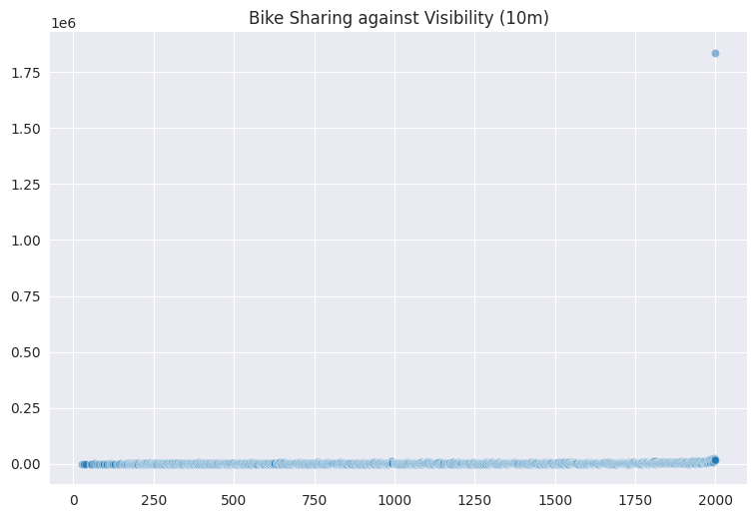
Rented Bike Count Against Numerical Data
Dew point temperature between 5-25 Degrees is most favorable for Bike sharing.
Demand for bikes dwindles in case of rainfall.
Visibility is an important factor for bike riders, bike sharing is at its peak when the visibility is maximum

Slide 14
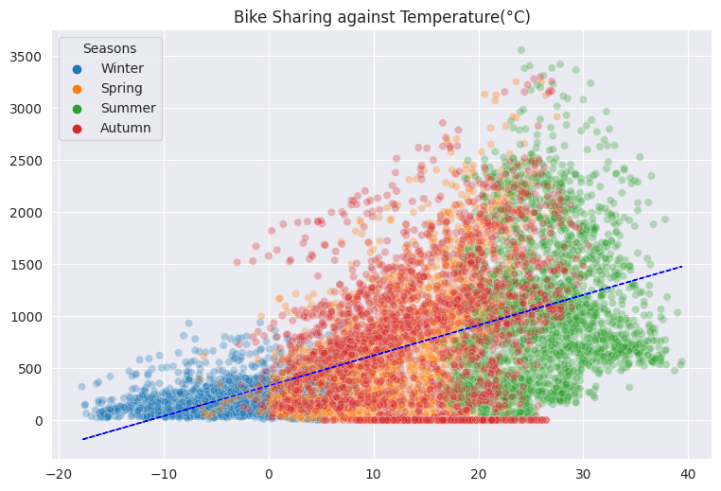
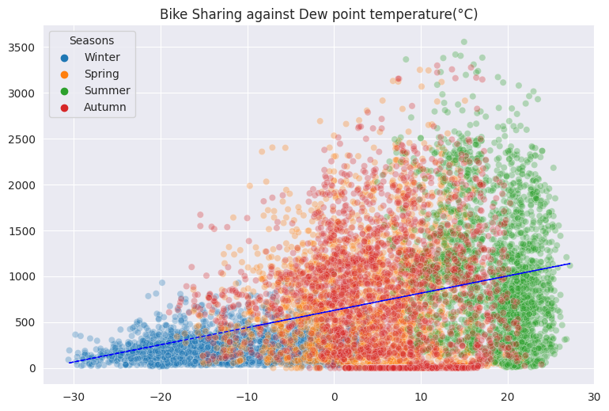
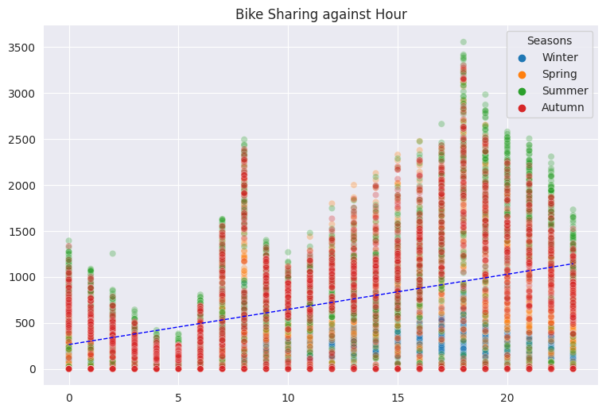
Co-relation: Rented bike count vs Temp, Dew point Temp, Hour
Bike sharing is positively co-related to temperature and Dew point Temperature as the temperature approaches 30 degrees.
Though one thing to notice the positive co-relation is applicable only because the temperature in Seoul rarely crosses 40 Degrees.
Bike sharing count is positively co-related to hours as the Hours Progress from 0 (12 am) to 20 (8 pm) the bike-sharing count increases.

Slide 15
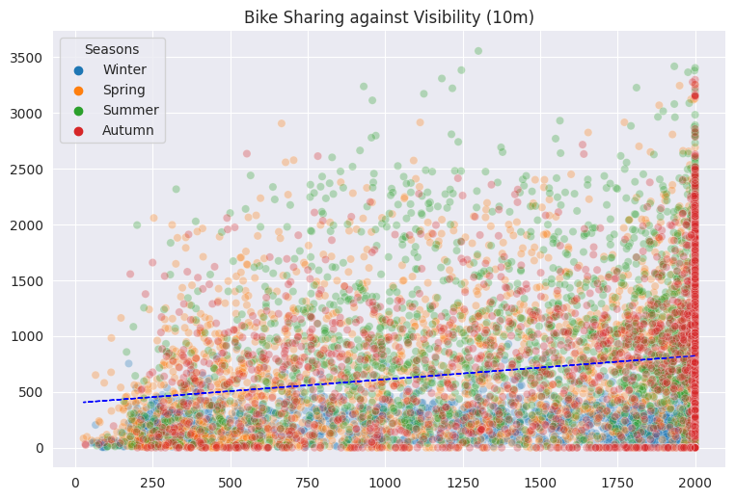
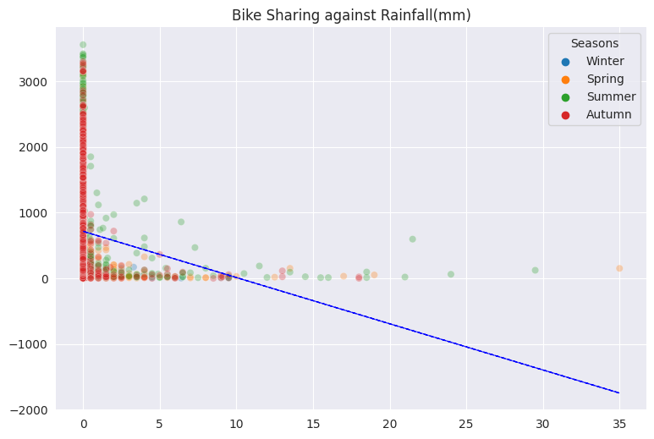
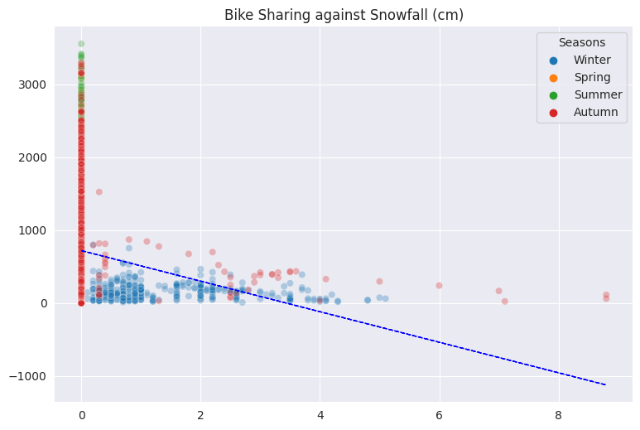
Co-relation: Rented bike count vs Visibility, Rainfall, Snowfall
Visibility is Also slightly positively co-related with Bike Bookings.
Snowfall, Rainfall are negatively co-related to Bike rented count.

Slide 16
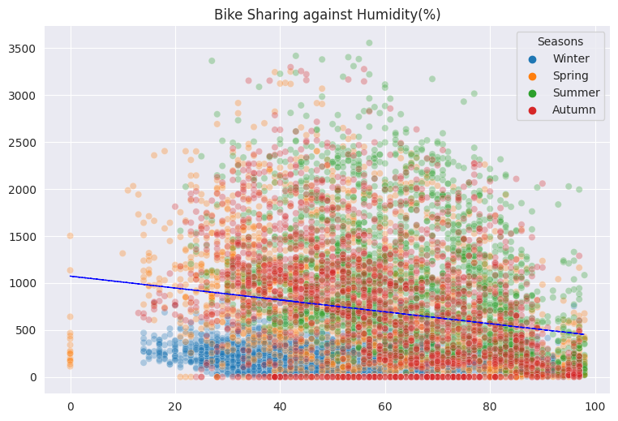
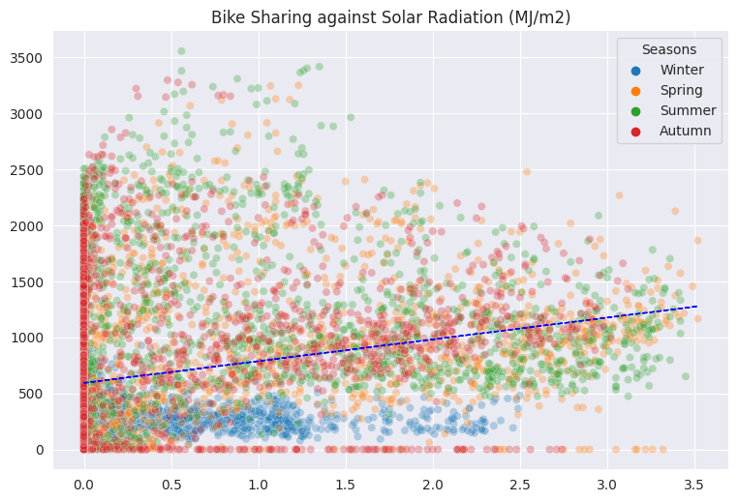
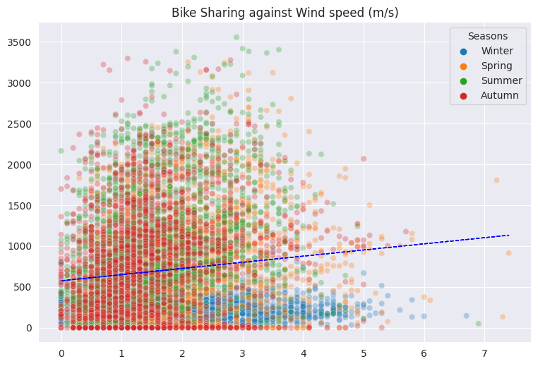
Co-relation: Rented bike count vs Humidity, Wind Speed, Radiation
The bike-sharing count is slightly negatively correlated to Humidity.
Wind speed and Solar radiation are slightly positively related to Bike-sharing count.

Slide 17
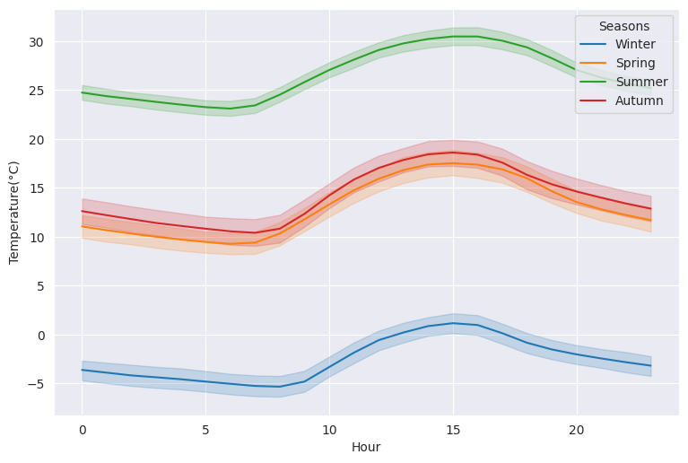
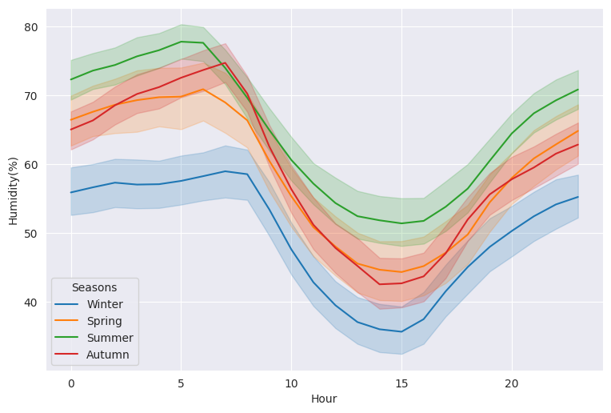
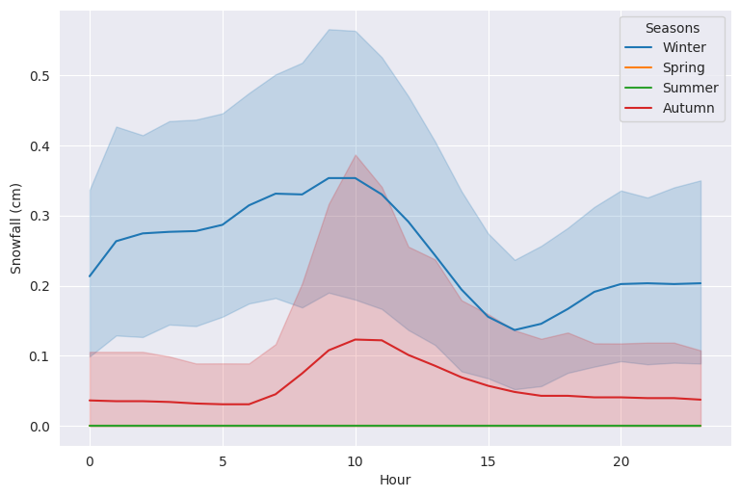
Climate Effect in Different seasons on Bike Sharing
Temperature in Summer varies between 24-31 Degrees, in Autumn it varies between10-18 Degrees. Spring temperatures are between 9-16 Degrees, for winter the range is -5-3 Degrees.
Humidity in Summer ranges from 52% - 77%, in Autumn its 43% -74%, for spring it varies from 41%-71%, for winter the humidity is least from 36%-59%
Seoul experiences Heavy snowfall in winter followed by Autumn. Snowfall is one of the factors affecting Bike bookings.

Slide 18
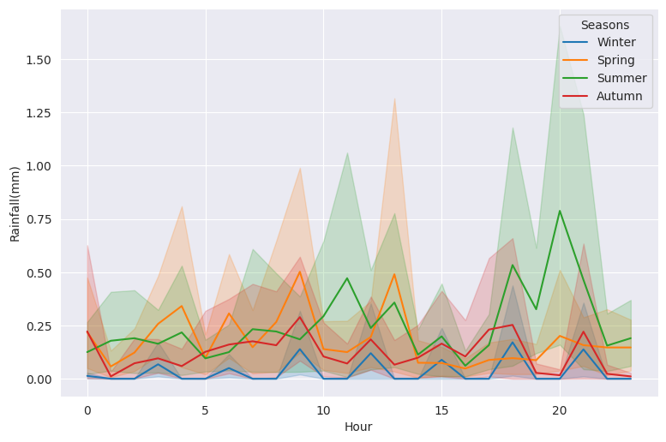
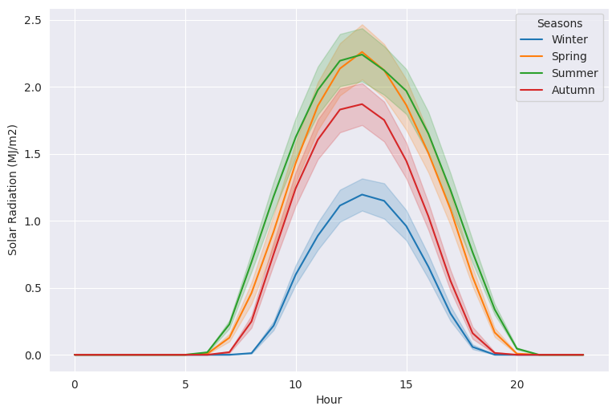
Climate Effect in Different seasons on Bike Sharing
Solar Radiation is at its peak between 13:30pm -2:30 pm in Seoul across all the seasons.
Summer and Spring have the highest recorded solar Radiation of 2.25 MJ/m2. Peak radiation in Autumn and Winter is around 1.8 MJ/m2 and 1.2 MJ/m2.
Rainfall is most likely to occur in summer and Spring in Seoul.

Slide 19
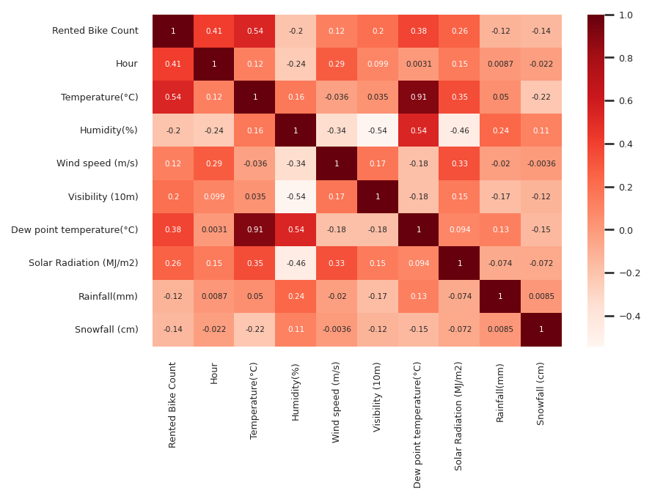
Correlation map
Heat map shows slightly positive relation of Rented bike count with Hour, Temperature, Dew point Temperature, Solar Radiation.
Bike sharing count is negatively co-related to Humidity, Snowfall, Rainfall.
Temperature and Dew point temperature are positively co-related.

Slide 20
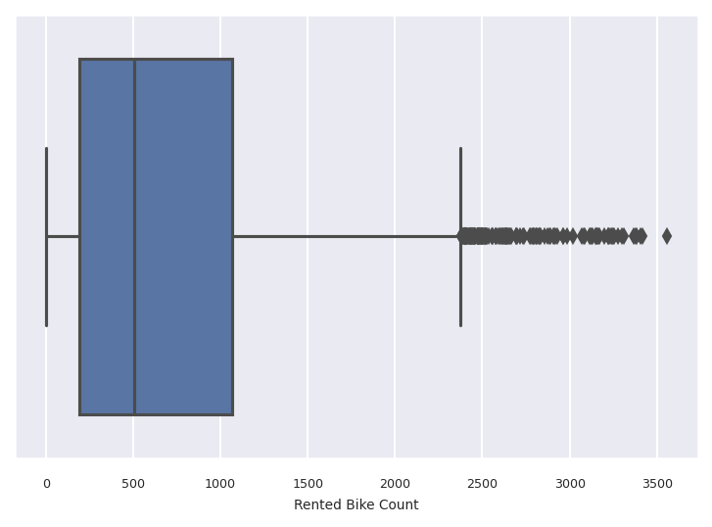
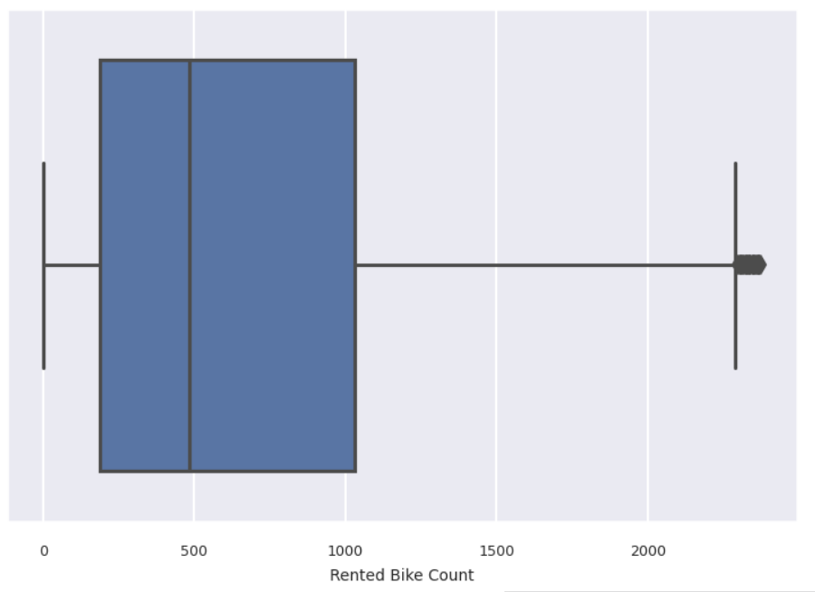
Dealing with Outliers
Boxplot of Rented bike count depicts the presence of a high range of outliers.
Using IQR process to remove outliers
Rented bike column indicating negligible or 0 outlier values.
Q1 = df.quantile(0.25)
Q3 = df.quantile(0.75)
IQR(Inter-quartile range) = Q3 - Q1
Lower range = Q1 – 1.5*IQR
Higher range = Q2 + 1.5*IQR

Slide 21
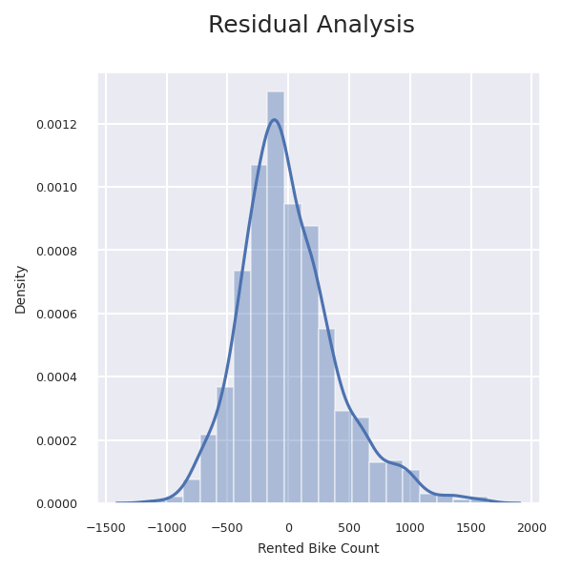
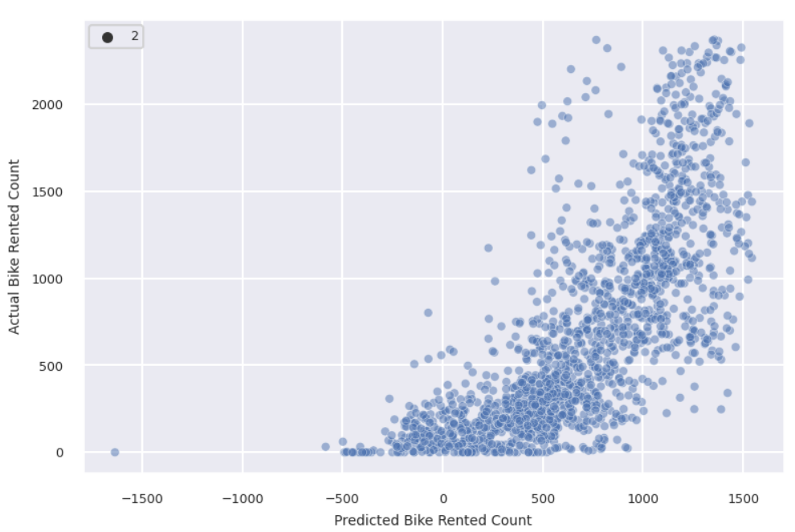
Linear Regression Analysis
It’s evident that a simple linear model is not giving us much accuracy.
R-score is 0.55 and Adj R-score is 0.54. MSE : 155676.03 MAE : 301.067 RMSE : 394.558
Linear Regression model residual values ranging from -1500 to 2000.

Slide 22
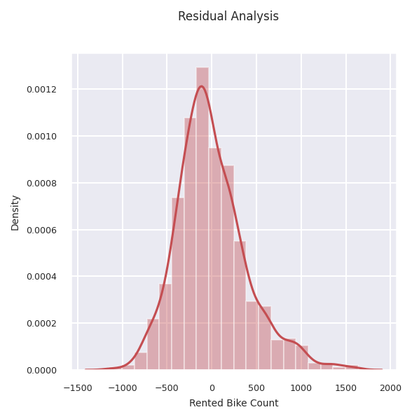
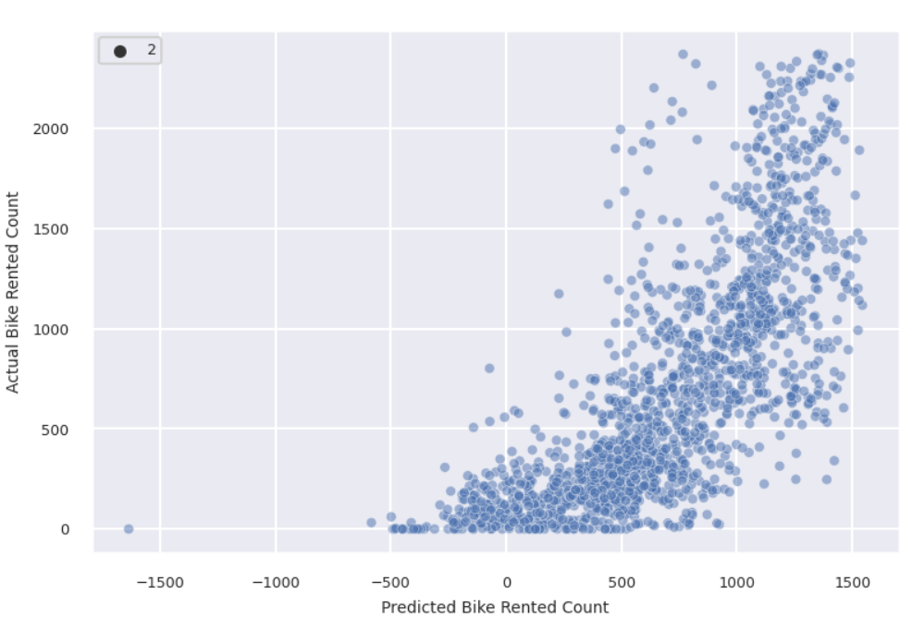
Lasso Regression Analysis
Using Lasso regression, the model accuracy has been further reduced slightly.
R-Score is 0.55 and Adj R-score is 0.54 MSE : 155673.688 MAE : 301.06 RMSE : 394.555
The Residual plot more or less remains the Same even with the Lasso Regression.

Slide 23
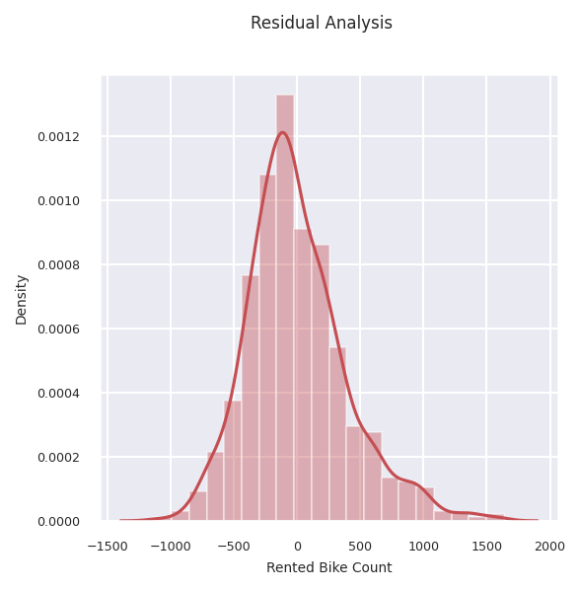
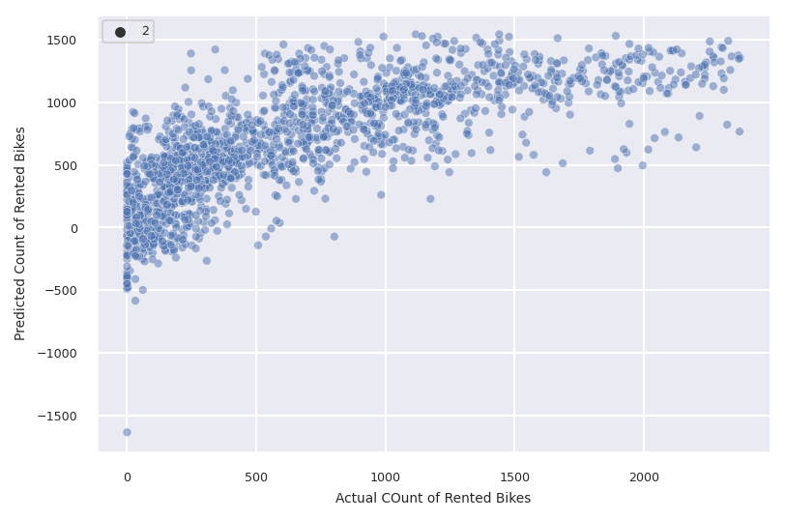
Hyperparameter Tuning Lasso Regression
Accuracy using Hyperparameter as well is low.
R-Score 0.55 and Adjusted R-score 0.54 MSE : 155675.8669 MAE : 301.0676 RMSE : 394.5578
Residual plot remains the same using Hyperparameters as well.
Possible reasons of such low accuracy using the Linear model is low linear relationship, low correlation between dependent and independent variables.

Slide 24
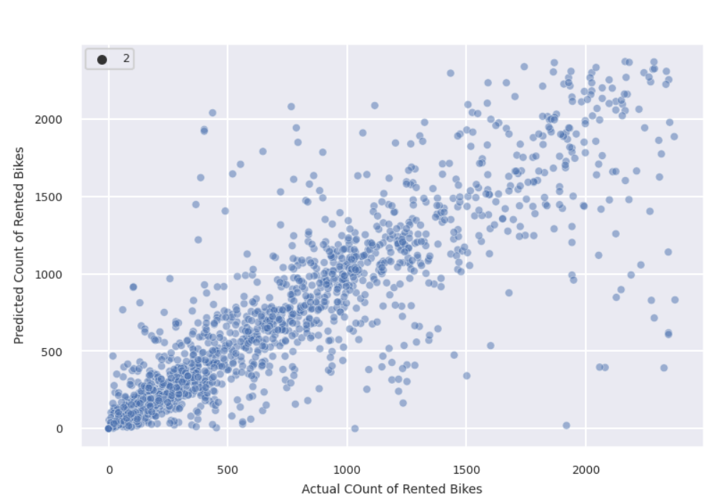
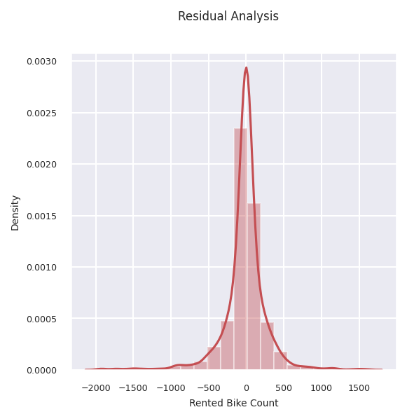
Decision Tree Analysis
Decision tree improves the accuracy significantly on the Test set. its evident from the below plot the Predicted and actual values are much closer compared to Linear Model
R-score of 0.754 and Adjusted R-score of 0.751, MSE : 83584.7431, MAE : 164.4561, RMSE : 289.1102
Residual values are reduced remarkably for the Decision tree. The KDE plot is much leaner and most of the Residual values are closer to zero.

Slide 25
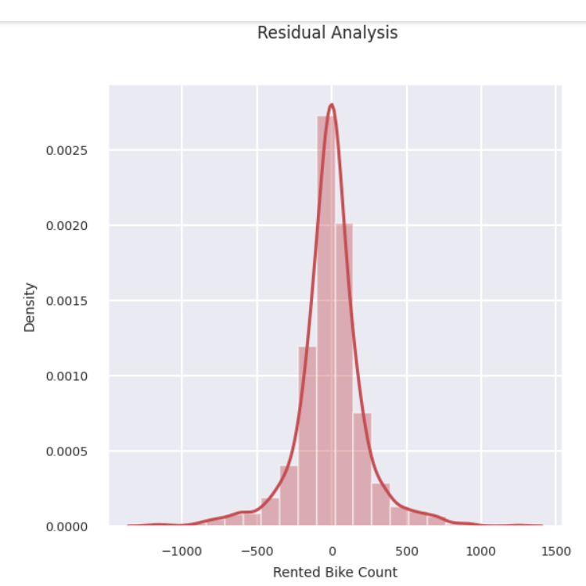
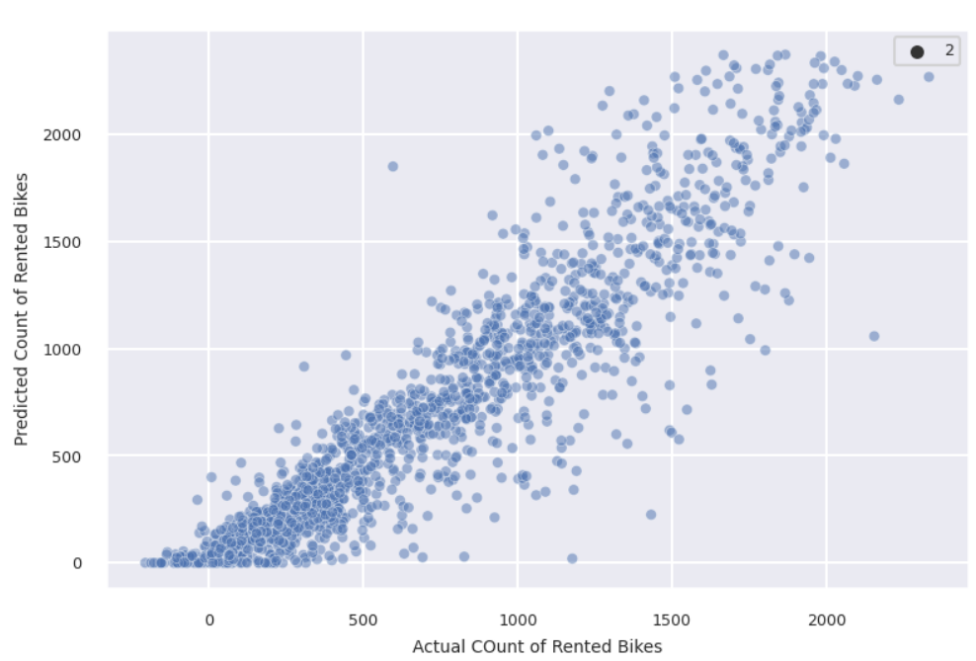
Cat Boost Analysis
R-score of 0.853 and Adjusted R-score of 0.852, MSE : 50554.194, MAE : 149.230, RMSE : 224.842
Residual values are condensed remarkably towards zero for the Cat Boost. The KDE plot is much leaner and most of the Residual values are closer to zero.

Slide 26
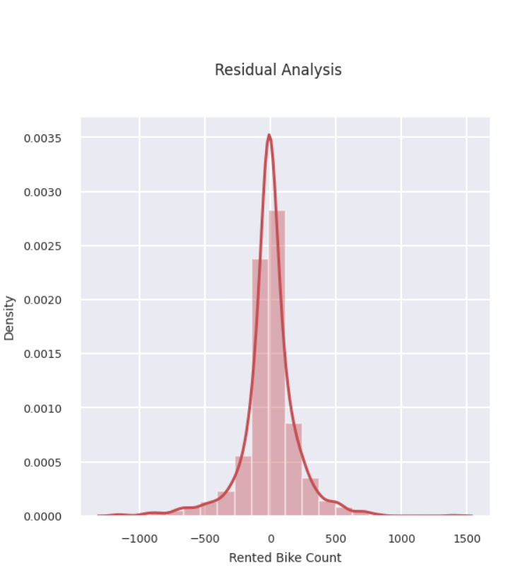
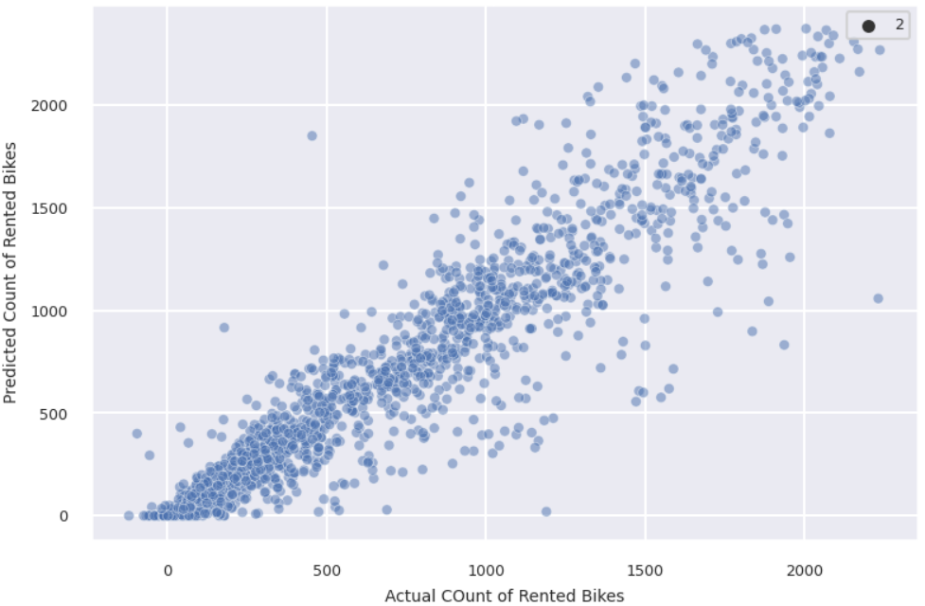
XG Boost Analysis
R-score of 0.872 and Adjusted R-score of 0.871, MSE : 44091.547 , MAE : 131.533, RMSE : 209.979
Residual values are condensed remarkably towards zero for the XG Boost. The KDE plot is much leaner and most of the Residual values are closer to zero.

Slide 27
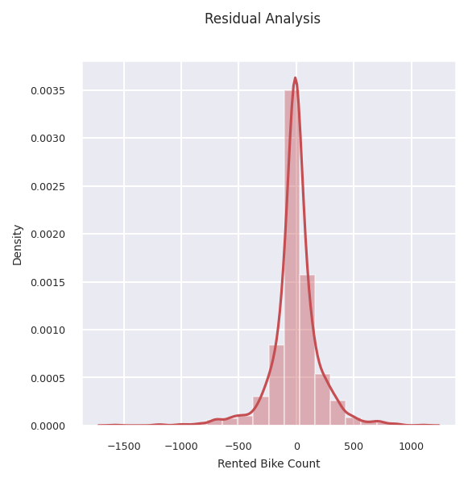
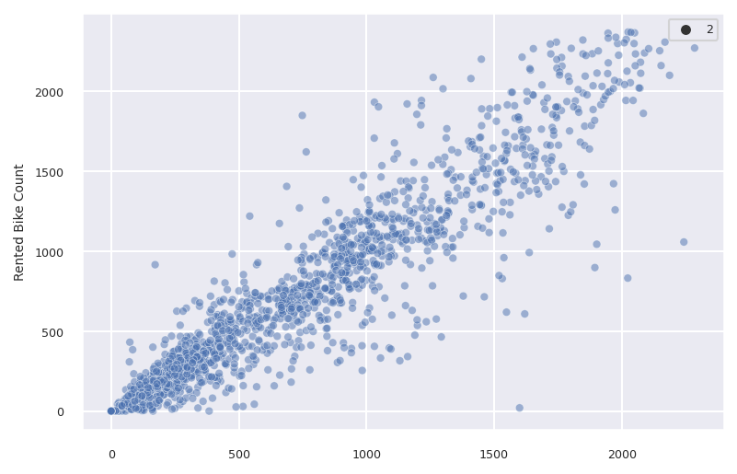
Random Forest Analysis
R-score of 0.876 and an Adjusted R-score of 0.875. MSE : 42747.1446 MAE : 128.21 RMSE : 206.753
Predicted and actual values of the test set follow an ideal line relation here.
The Residual error is reduced significantly using Random forest. The majority of the Residual error are condensed around zero.

Slide 28
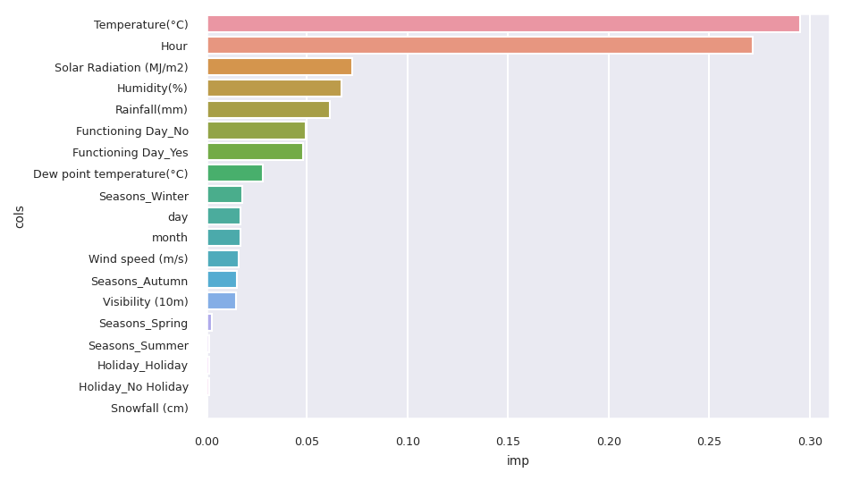
Feature Importance
The adjacent Graph shows the importance of the features on our Rented bike count.
Temperature and Hour of the day is a major factors driving the demand for bikes.
Solar Radiation, Humidity, Rainfall, where its working day or not are other variables driving the demand for bikes.

Slide 29
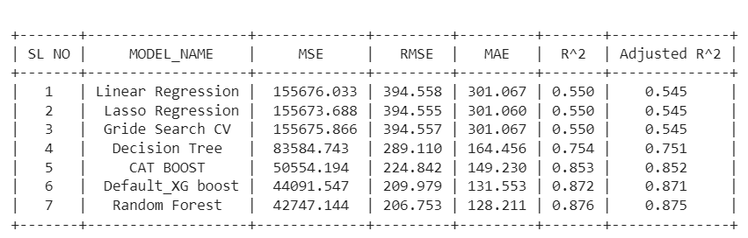
Prediction Summary
Predictions of the Linear Model are low due to the weak linear relationship between the dependent and independent variables.
The nonlinear model appears to give better accuracy. Best predictions are obtained from Random forests with a test data accuracy of 0.875.

Slide 30
Conclusion
Most numbers of Bikes were rented in Summer, followed by Autumn, Spring, and Winter. May-July is the peak Bike renting Season, and Dec-Feb is the least preferred month for bike renting.
Majority of the client in the bike rental sector belongs to the Working class. This is evident from EDA analysis where bike demand is more on weekdays, working days in Seoul.
Temperature of 20-30 Degrees, evening time 4 pm- 8 pm, Humidity between 40%-60% are the most favorable parameters where the Bike demand is at its peak.
Temperature, Hour of the day, Solar radiation, and Humidity are major driving factors for the Bike rent demand.
Feature and Labels had a weak linear relationship, hence the prediction from the linear model was very low. Best predictions are obtained with a Random forest model with an accuracy of 0.875

Slide 31
Q & A

